Slide 1
NLP Synthetic Data lecture 02.2
Branko Žitko

Slide 2

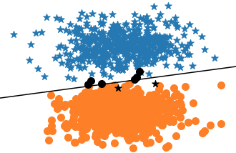
Constructing Synthetic Data
It is a common practice to create synthetic data with well-understood properties when trying to understand an algorithm.
Example task is for classifying two-dimensional points into one of two classes:
blue stars
orange circles
This means learning a single line, called a decision boundary or hyperplane, to discriminate the points of one class from the other.

Slide 3
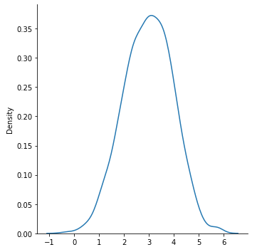
Constructing Synthetic Data
It is common to keep "randomness" controlled by setting seed number. It guarantees that, every time we run code, the same random numbers will be generated.
import numpy as np import seaborn as sns import pandas as pd import torch import torch.nn seed = 1337 torch.manual_seed(seed) torch.cuda.manual_seed_all(seed) np.random.seed(seed)
Generating 1000-dim vector with random normal distribution with mean equal to 3.
x = np.random.normal(3, size=1000) sns.displot(x, kind="kde")

Slide 4
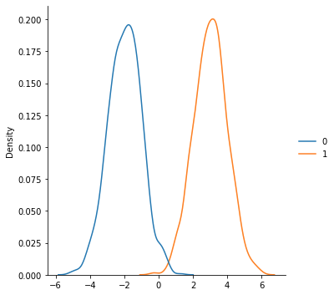
Constructing Synthetic Data
Generating 1000x2 dim matrix. Each row is 2-dim vector whose the first element is from random normal distribution with mean equal to -2, and the second element is from random normal distribution with mean equal to 3.
x = np.random.normal(loc=(-2, 3), size=(1000, 2)) sns.displot(x, kind="kde") x
array([[ 0.3939396 , 1.90755365], [-1.93873024, 3.50520505], [-1.35967665, 0.79043469], ..., [-4.21626911, 4.55055046], [-1.29548413, 2.87007834], [-1.05369464, 2.04545469]])

Slide 5
Constructing Synthetic Data
uniform distribution is used to disseminate data into two classes elements of the first class (blue stars) elements of the second class (orange circles)
TOP_CENTER = (3, 3) BOTTOM_CENTER = (3, -2) def get_toy_data(batch_size, top_center=TOP_CENTER, bottom_center=BOTTOM_CENTER): x_data = [] y_targets = np.zeros(batch_size) for batch_i in range(batch_size): if np.random.random() > 0.5: # (1) x_data.append(np.random.normal(loc=top_center)) # (2) y_targets[batch_i] = 1 else: x_data.append(np.random.normal(loc=bottom_center)) # (3) return (torch.tensor(x_data, dtype=torch.float), torch.tensor(y_targets, dtype=torch.float)) x_data, y_truth = get_toy_data(10) x_data, y_truth
(tensor([[ 4.2900, -2.3396], [ 3.2726, -1.2065], [ 2.9597, 3.8050], [ 0.6997, 0.9042], [ 3.5776, 3.4091], [ 3.8604, -0.0618], [ 5.3586, 3.8221], [ 0.6602, -2.7646], [ 4.6037, -3.4670], [ 3.1307, -0.9266]]), tensor([0., 0., 1., 1., 1., 0., 1., 0., 0., 0.]))

Slide 6
Plotting Synthetic Data
meshgrid() is used to create a rectangular grid out of two given one-dimensional arrays representing the Cartesian indexing.
x = np.linspace(0, 5, 6) y = np.linspace(0, 9, 10) xx, yy = np.meshgrid(x, y) print(xx) print() print(yy)
[[0. 1. 2. 3. 4. 5.] [0. 1. 2. 3. 4. 5.] [0. 1. 2. 3. 4. 5.] [0. 1. 2. 3. 4. 5.] [0. 1. 2. 3. 4. 5.] [0. 1. 2. 3. 4. 5.] [0. 1. 2. 3. 4. 5.] [0. 1. 2. 3. 4. 5.] [0. 1. 2. 3. 4. 5.] [0. 1. 2. 3. 4. 5.]] [[0. 0. 0. 0. 0. 0.] [1. 1. 1. 1. 1. 1.] [2. 2. 2. 2. 2. 2.] [3. 3. 3. 3. 3. 3.] [4. 4. 4. 4. 4. 4.] [5. 5. 5. 5. 5. 5.] [6. 6. 6. 6. 6. 6.] [7. 7. 7. 7. 7. 7.] [8. 8. 8. 8. 8. 8.] [9. 9. 9. 9. 9. 9.]]

Slide 7
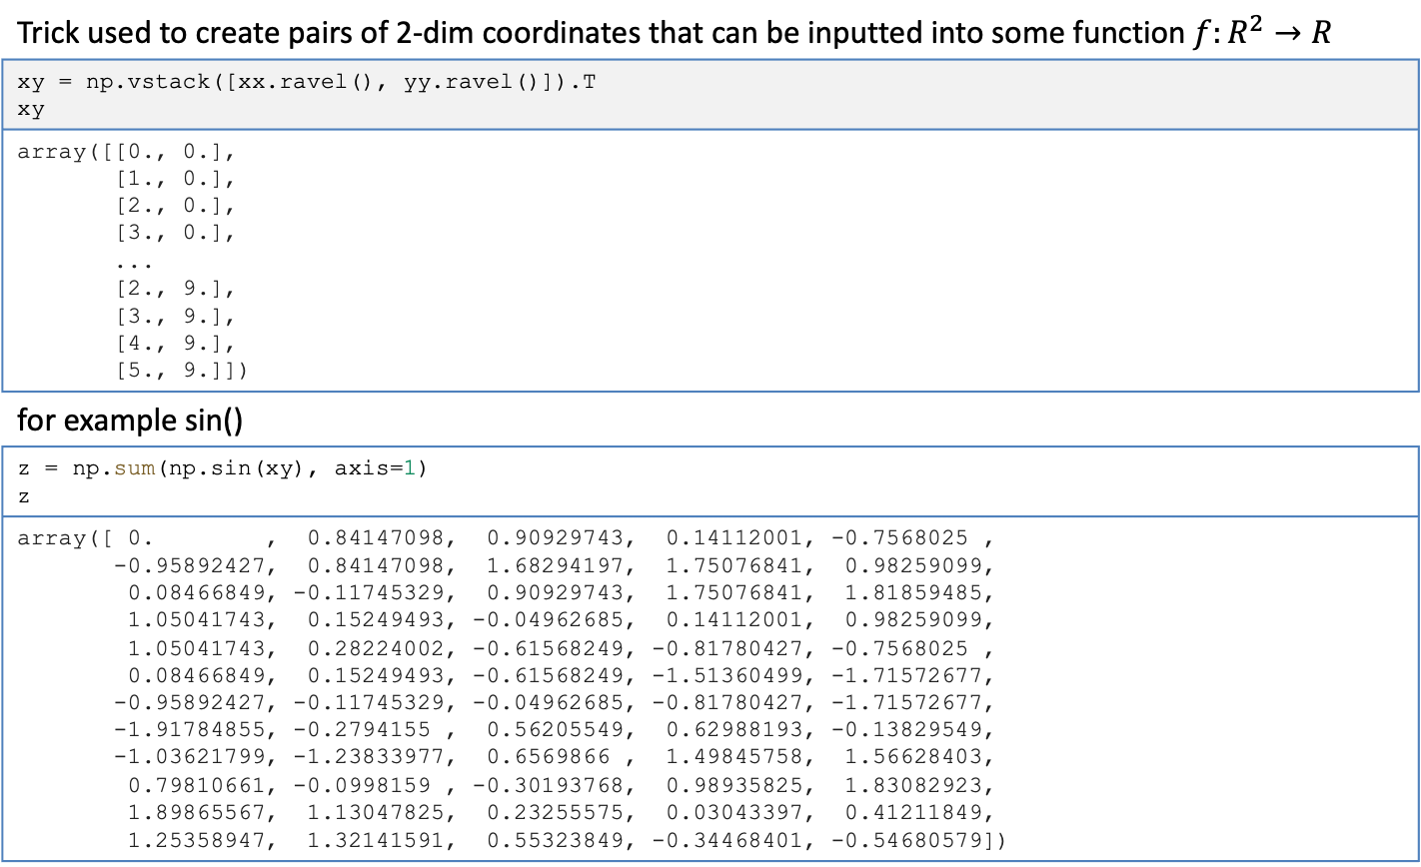
Plotting Synthetic Data
Trick used to create pairs of 2-dim coordinates that can be inputted into some function $f:R^{2}→R$
xy = np.vstack([xx.ravel(), yy.ravel()]).T xy
array([[0., 0.], [1., 0.], [2., 0.], [3., 0.], ... [2., 9.], [3., 9.], [4., 9.], [5., 9.]])
for example sin()
z = np.sum(np.sin(xy), axis=1) z
array([ 0. , 0.84147098, 0.90929743, 0.14112001, -0.7568025 , -0.95892427, 0.84147098, 1.68294197, 1.75076841, 0.98259099, 0.08466849, -0.11745329, 0.90929743, 1.75076841, 1.81859485, 1.05041743, 0.15249493, -0.04962685, 0.14112001, 0.98259099, 1.05041743, 0.28224002, -0.61568249, -0.81780427, -0.7568025 , 0.08466849, 0.15249493, -0.61568249, -1.51360499, -1.71572677, -0.95892427, -0.11745329, -0.04962685, -0.81780427, -1.71572677, -1.91784855, -0.2794155 , 0.56205549, 0.62988193, -0.13829549, -1.03621799, -1.23833977, 0.6569866 , 1.49845758, 1.56628403, 0.79810661, -0.0998159 , -0.30193768, 0.98935825, 1.83082923, 1.89865567, 1.13047825, 0.23255575, 0.03043397, 0.41211849, 1.25358947, 1.32141591, 0.55323849, -0.34468401, -0.54680579])

Slide 8
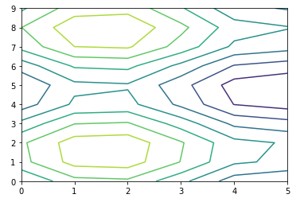
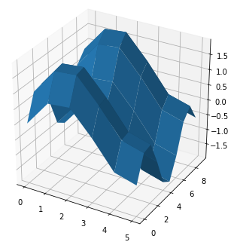
Plotting Synthetic Data
Plotting contours of the applyed function
plt.contour(xx, yy, z.reshape(xx.shape))
fig = plt.figure(figsize=(6,6)) ax = fig.add_subplot(111, projection='3d') ax.plot_surface(xx, yy, z.reshape(xx.shape))

Slide 9
Plotting Synthetic Data
black_blue and black_orange lists will contain wrongly predicted data points for blue and orange classes perceptron is optional, if it is set, then predictions are calculated check if data point will be black
def plot_toy_data(x_data, y_truth, perceptron=None): blue = [] orange = [] black_blue = [] # (1) black_orange = [] if perceptron: # (2) y_pred = perceptron(x_data).squeeze().detach() y_pred = (y_pred > 0.5).float() else: y_pred = y_truth for x_i, y_true_i, y_pred_i in zip(x_data, y_truth, y_pred): is_black = y_true_i != y_pred_i # (3) if y_true_i == 1: if is_black: black_blue.append(x_i) else: blue.append(x_i) else: if is_black: black_orange.append(x_i) else: orange.append(x_i)

Slide 10
Plotting Synthetic Data
plotting correct blue stars plotting correct orange circles plotting wrong blue stars as black plotting wtong blue circles as black plotting hyperplane that divides predictions
if blue: blue = np.stack(blue) # (4) plt.scatter(blue[:,0], blue[:,1], marker="*", c="tab:blue", s=100) if orange: orange = np.stack(orange) # (5) plt.scatter(orange[:,0], orange[:,1], marker="o", c="tab:orange", s=100) if perceptron: if black_blue: # (6) black_blue = np.stack(black_blue) plt.scatter(black_blue[:,0], black_blue[:,1], marker="*", c="black", s=100) if black_orange: # (7) black_orange = np.stack(black_orange) plt.scatter(black_orange[:,0], black_orange[:,1], marker="o", c="black", s=100) # hyperplane xx = np.linspace(x_data[:,0].min() - 0.5, x_data[:,0].max() + 0.5, 30) # (8) yy = np.linspace(x_data[:,1].min() - 0.5, x_data[:,1].max() + 0.5, 30) xv, yv = np.meshgrid(xx, yy) xy = np.vstack([xv.ravel(), yv.ravel()]).T z = perceptron(torch.tensor(xy, dtype=torch.float)).detach().numpy().reshape(yv.shape) plt.contour(xx, yy, z, colors='k', levels=[0.5]) plt.show()

Slide 11
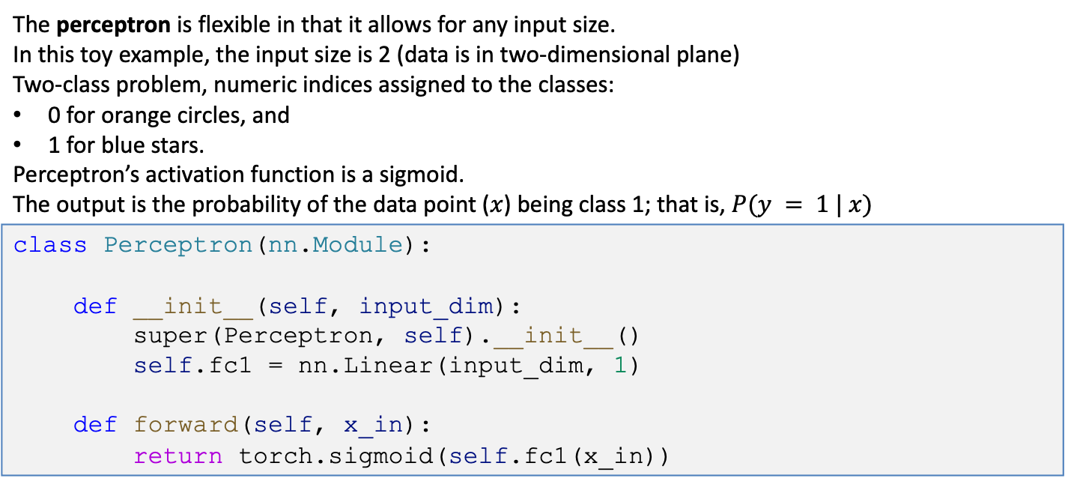
Choosing a model
The perceptron is flexible in that it allows for any input size. In this toy example, the input size is 2 (data is in two-dimensional plane) Two-class problem, numeric indices assigned to the classes: 0 for orange circles, and 1 for blue stars. Perceptron’s activation function is a sigmoid. The output is the probability of the data point ($x$) being class 1; that is, $P(y = 1 | x)$
class Perceptron(nn.Module): def __init__(self, input_dim): super(Perceptron, self).__init__() self.fc1 = nn.Linear(input_dim, 1) def forward(self, x_in): return torch.sigmoid(self.fc1(x_in))

Slide 12
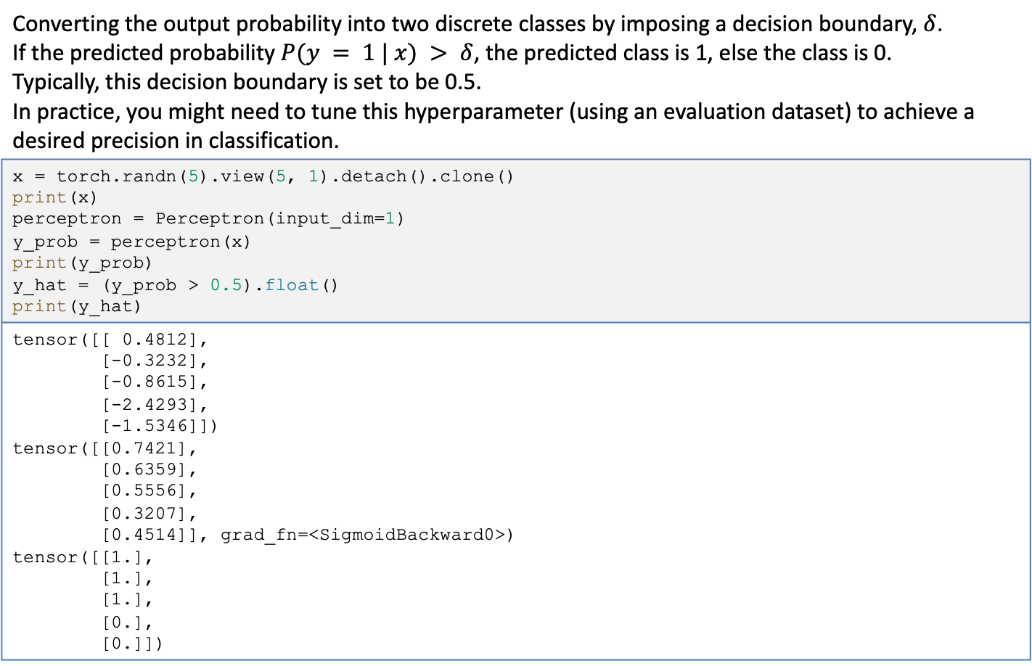
Converting the probabilities to discrete classes
Converting the output probability into two discrete classes by imposing a decision boundary, $δ$. If the predicted probability $P(y = 1 | x) > δ$, the predicted class is 1, else the class is 0. Typically, this decision boundary is set to be 0.5. In practice, you might need to tune this hyperparameter (using an evaluation dataset) to achieve a desired precision in classification.
x = torch.randn(5).view(5, 1).detach().clone() print(x) perceptron = Perceptron(input_dim=1) y_prob = perceptron(x) print(y_prob) y_hat = (y_prob > 0.5).float() print(y_hat)
tensor([[ 0.4812], [-0.3232], [-0.8615], [-2.4293], [-1.5346]]) tensor([[0.7421], [0.6359], [0.5556], [0.3207], [0.4514]], grad_fn=<SigmoidBackward0>) tensor([[1.], [1.], [1.], [0.], [0.]])

Slide 13
Choosing a loss function and optimizer
For situations in which the model’s output is a probability, the most appropriate family of loss functions are cross entropy–based losses. For this toy data example, because the model is producing binary outcomes, we specifically use the BCE loss.
bce_loss = torch.nn.BCELoss()
tensor([[ 0.4812], [-0.3232], [-0.8615], [-2.4293], [-1.5346]]) tensor([[0.7421], [0.6359], [0.5556], [0.3207], [0.4514]], grad_fn=<SigmoidBackward0>) tensor([[1.], [1.], [1.], [0.], [0.]])

Slide 14
Choosing a loss function and optimizer
The optimizer updates the weights of the model using the error signal. In its simplest form, there is a single hyperparameter that controls the update behavior of the optimizer. This hyperparameter, called a learning rate, controls how much impact the error signal has on updating the weights: Large learning rates will cause bigger changes to the parameters and can affect convergence. Too-small learning rates can result in very little progress during training. Stochastic gradient descent (SGD) is a classic algorithm of choice. SGD has convergence issues, often leading to poorer models. The current preferred alternative are adaptive optimizers, such as Adagrad or Adam, which use information about updates over time.
import torch.nn as nn import torch.optim as optim input_dim = 2 lr = 0.001 perceptron = Perceptron(input_dim=input_dim) bce_loss = nn.BCELoss() optimizer = optim.Adam(params=perceptron.parameters(), lr=lr)

Slide 15
Gradient-Based Supervised Learning
each epoch is a complete pass over the training data the inner loop is over the batches in the dataset get the data clear the gradients compute the forward pass of the model compute the loss value that we wish to optimize propagate the loss signal back trigger the optimizer to perform one update
batch_size = 1000 n_epochs = 12 n_batches = 5 for epoch_i in range(n_epochs): #(1) for batch_i in range(n_batches): #(2) x_data, y_target = get_toy_data(batch_size) #(3) optimizer.zero_grad() #(4) y_pred = perceptron(x_data).squeeze() #(5) loss = bce_loss(y_pred, y_target) #(6) loss.backward() #(7) optimizer.step() #(8) print(f"epoch: {epoch} loss: {loss:0.3}") plot_toy_data(x_data_static, y_truth_static, perceptron)

Slide 16
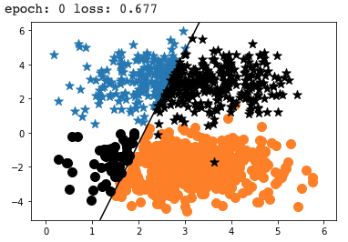
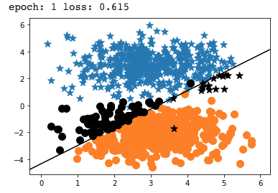
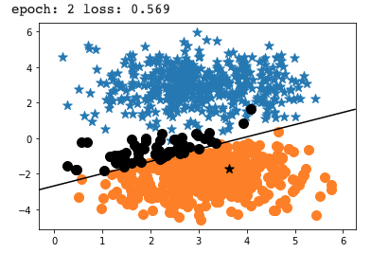
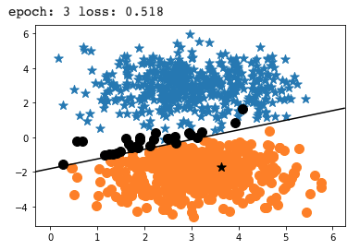
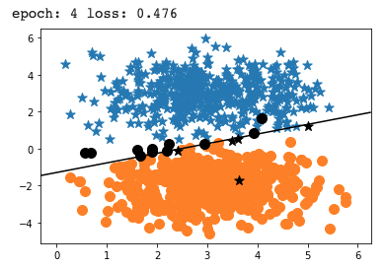
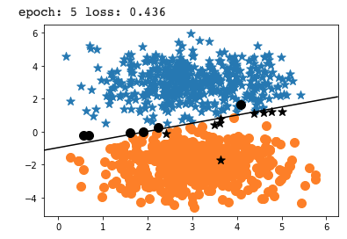
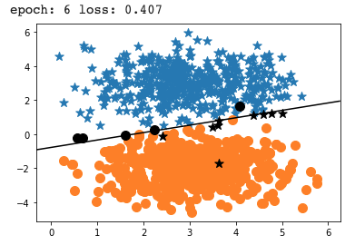
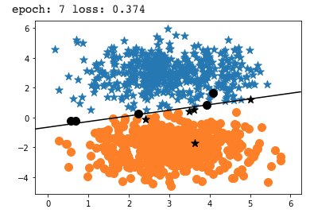
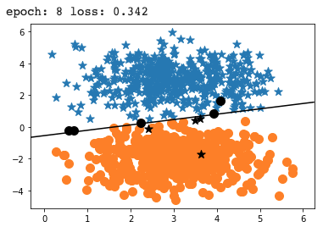
Gradient-Based Supervised Learning

